Slide 1
Space Flight
Gyroscopes
LabRat Scientific
© 2018

Slide 2
Various Types of Gyroscopes
Mechanical – A small metallic disk (a.k.a. rotor) is stabilized by the angular momentum that is generated when the rotor is spun at a very high spin rate. The rotor is housed in a 3-axis gimbal mechanism that allows the frame of the gyro (and thus the body of the vehicle) to rotate freely around the spinning rotor. Low friction electrical pick-ups on the gimbal axles are used to determine the position of the gyro body relative to the spinning rotor.
MEMS (Miniature Electrical Mechanical Systems) – These devices use a very small metal-ceramic mass that is attached to an unbelievably fine spring mechanism. The special mass expands and contacts when it is subjected to an alternating electrical current. When the mass is subjected to a pulsing electrical current it grows and shrinks along a single axis, and this dynamic motion creates a stabilizing effect. When the gyro is moved, the mass has a tendency to stay in the same orientation. The orientation of the mass can then be measured using extremely fine position sensors. These gyros are found in smart phones and drones. Their accuracy is only on the order of a few degrees.

Slide 3
Various Types of Gyroscopes
Fiber Optic – A beam of light is split by a semi-transparent mirror and the two beams travel in opposite directions along a long coil of fiber optic cable. As the gyro is rotated, one of the light beams begins to lag the other ever so slightly and the waves of the two light beams become slightly out of phase. When both beams recombine at a diode detector at the end of the coil an interference pattern is created. The magnitude of the phase shift of the pattern is proportional to the rotation rate of the gyro.
Ring Laser – A Ring Laser gyro works in much the same way as a fiber optic gyro except there is no fiber optic cable. The light beams travel in the opposite directions through a guide tube and rotation of the gyro induces a minute difference in the frequencies of the beams. An interference pattern is created when the two light beams are compared to one another after traveling around the tube. As the interference pattern shifts due to changing rotational rates of the vehicle, the diode sends out electrical pulses. Each pulse is a small angle of rotation and the frequency of the pulses represents the angular rate.

Slide 4
Things that Gyroscopes can Sense
Orientation – A gyro can be used to measure how far the gyro frame has moved from some initial reference orientation. Prior to use, a gyro is “caged”, which means its three principle axes are aligned with the three principle axes of the body (i.e. spacecraft) holding the gyro. In a mechanical gyro this is done mechanically. In an optical gyro this is done electronically. A some point (usually before take off or launch) the gyro is “uncaged” and the gyro is free to rotate inside the gyro housing and spacecraft. It’s not quite the same thing for an optical gyro since it has no moving parts, but technically the same idea. Low friction potentiometers are used to determine how far the housing has rotated around the stabilized spinning gyro disk.
Rates – The stabilized spinning rotor can be attached to a spring. The rotor deflects inside the housing but is retarded by the spring. The larger the rate (i.e. pitch rate), the larger the deflection. The deflection is measured by very fine sensors.

Slide 5
Everyday Gyroscopes
Spinning Top – A toy top is a simple gyroscope. The top doesn’t fall over due to the stabilizing effect of the spin and the associated angular momentum vector.
Bicycle – One of the reasons you can balance on a bicycle is the fact that the two wheels serve as gyros that stabilize the bicycle and keep it from falling over. Have you ever noticed that it is easier to balance on a bike when it’s moving compared to when it’s standing still? Part of this is due to the forward motion of the bike and your brain making corrections, but another part of it is due to the spinning wheels acting as gyroscopes.

Slide 6
Everyday Gyroscopes
Perfectly Thrown Football – The perfect “spiral” pass relies on gyroscopic forces interacting with aerodynamic forces to ensure the spinning axis of the football follows along the flight elevation of the ball’s trajectory.

Slide 7
Roll Axis
Basic Anatomy of a Mechanical Gyro
The gimbals and associated low friction bearings decouple the spinning rotor from the body of the vehicle.
Low friction sensors on the gimbal axles detect the orientation between the rotor and the vehicle.
Rotor
Pitch Axis
Gimbals
Yaw Axis
Frame

Slide 8
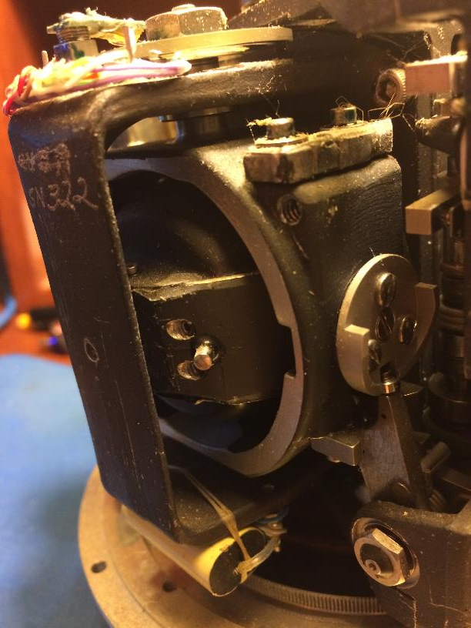
Mechanical Gyro
The spinning rotor is housed in this mechanism.
Potentiometer for determining rotational position
Low friction bearing
Mechanism to “cage” the gyro
Note: This technology is quite old and this device is obsolete…

Slide 9
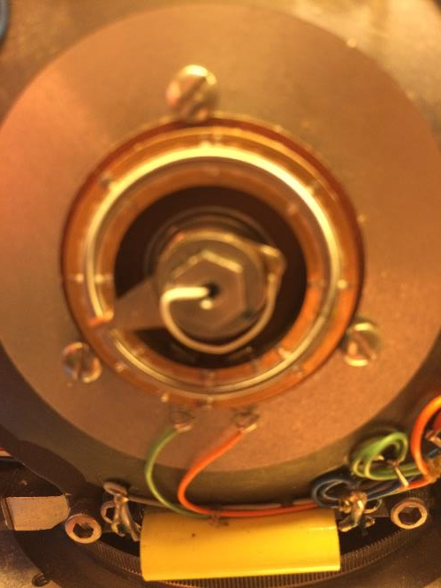
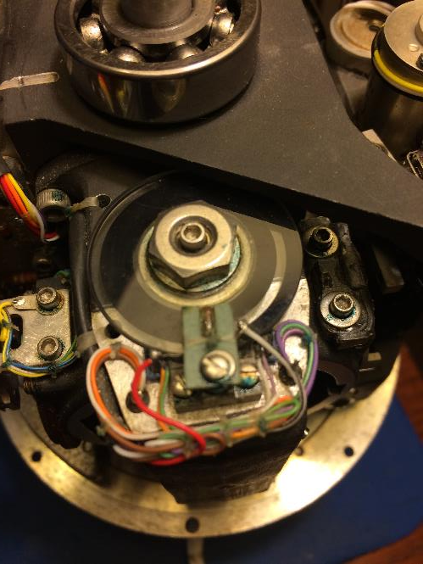
Mechanical Gyro
Potentiometers that are used to determine the orientation of the gyro body relative to the spinning gyro rotor.
Note: This technology is quite old and this device is obsolete…

Slide 10
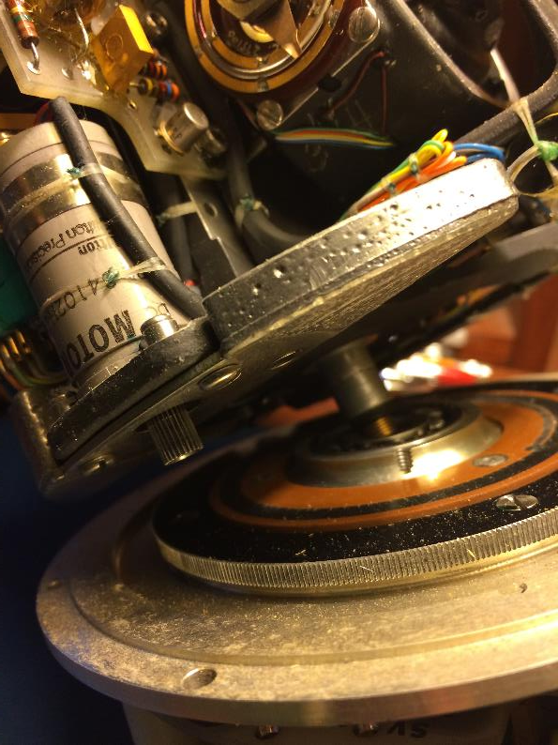
Mechanical Gyro
This gyro is “spin stabilized” which means the entire gyro platform is spun by an electric motor to exactly counteract the spin of the rocket. Spin stabilization is needed in mechanical gyros when the body is rotating at a high rate (i.e. 5 rev/sec).
Drive motor with gear
Spin of Gyro Platform
Large gear mounted to the base of the gyro frame
Spin of Rocket
Note: This technology is quite old and this device is obsolete…

Slide 11
Basic Functional Premise of a Mechanical Gyro
The gyro rotor has mass and is spinning at a high rotational rate.
This produces “Angular Momentum”, which is a vector that points out along the axis of rotation of the rotor.
As with any form of “momentum” which is a resistance to a change in motion, the angular momentum resists any change in rotational motion (along the spin axis or orthogonal to it). As a result, the momentum vector has a tendency to remain pointing in the same direction.
Gyro Rotor

Slide 12
Angular Momentum
There are several equations that can be used to calculate Angular Momentum (L). One such equation is as follows:
Angular Momentum = Rotational Inertia x Angular Rate
L = I x ꙍ
The Rotational Inertia for a spinning disk (i.e gyro rotor) is calculated as follows:
I = ½ Mass x Radius²
Radius
Mass of Rotor

Slide 13
Angular Momentum
L = I x ꙍ
I = ½ Mass x Radius²
From these equations, we can see that the Angular Momentum increases as the mass (m) of the rotor increases, or the radius (r) of the rotor increases, or the rotational velocity (ꙍ) of the rotor increases.
To make a very small mechanical gyro, it is necessary to have it spinning very fast. A rotor in a small gyro can spin at a rate of 24,000 revolutions per minute (400 rotations/sec) or more.

Slide 14
Spinning Rotor Response to an Applied Torque
Non-spinning Rotor
Spinning Rotor

Slide 15
Gyroscopic Precession
Precession: The change in the orientation of the rotational axis of a spinning body.
Precession Rate = Torque / Angular Momentum
Ω = τ / L
When a spinning top’s axis of rotation is not perfectly vertical, the offset center of gravity creates a torque which tries to tip the top over. However, since the top is spinning, the resultant motion is actually 90 degrees to the applied torque (the gyroscopic effect). As a result, the top’s axis of rotation will begin to sweep out a cone. This is known as precession and the precession rate is a function of the applied torque and the angular momentum. As friction reduces the spin rate of the top, the angular momentum decreases and the precession rate increases. Over time the top’s spin rate decreases to the point where the gravitational torque dominates and the top falls over.

Slide 16
Flight Trajectory Control using Gyros
Not only can a gyro be used to sense the orientation of a vehicle, it can also be used to control the fight path.
To do this, the gyro needs to be connected to a flight computer. The flight computer has the desired flight profile (body attitudes) programmed into it. As the attitude of the rocket needs to change, the program feeds “Error Signals” into the control algorithm and the system tries to null out (get rid of) the errors. The errors are nulled out when the attitude of the vehicle moves to the desired orientation. The orientation can be changed using movable fins or aerodynamic control surfaces, gimballed rocket nozzles, or thrusters.
If winds or other external forces cause the vehicle to deviate from its nominal flight path, unanticipated error signals will be generated and the flight computer will try to null them out and bring the vehicle back to where it should be.

Slide 17
Spacecraft Orientation Control Using
Control Moment Gyros
The orientation of a spacecraft can be mechanically altered using a gyro without the need for thrusters.
To do this, a heavy fly wheel (rotor) is connected to motorized gimbals. When the spacecraft needs to be reoriented, the motorized gimbals attempt to reorient the flywheel.
Since the spinning fly wheel has rotational inertia, it tries to resist the force being applied by the motorized gimbal. When this happens, Newton says an “equal and opposite reaction” will occur. As such, the motorized gimbal also pushes against the frame of the spacecraft. Since the spacecraft is free to rotate, its attitude changes.
The Control Moment Gyro is not the same gyro that is used to sense the orientation of the spacecraft…

Slide 18
Questions?

